Slide 1
Microprocessors and Microcontrollers
SERIAL COMMUNICATION USING ATMEGA16/32
Md. Tareq Mahmood
Original slides made by Azad Abdus Salam

Slide 2
Types of Data Communication
Data Communication
Serial
Parallel
Synchronous
Asynchronous

Slide 3
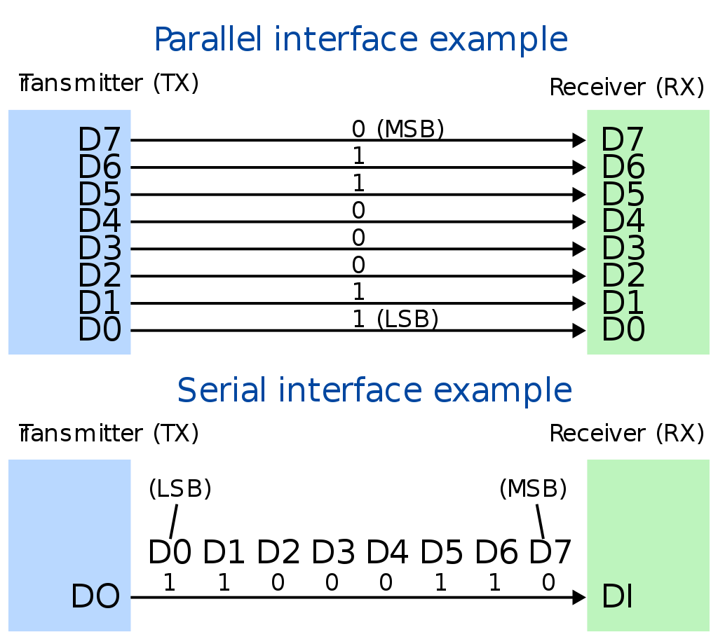
Serial vs. Parallel Communication

Slide 4
Serial vs. Parallel Communication
Computers transfer data in two ways: parallel and serial.
Parallel: Several data bits are transferred simultaneously, e.g., printers and hard disks.
Serial: A single data bit is transferred at one time, e.g., Bluetooth, USB, SSD

Slide 5
Why Serial Communication?
Synchronization: Clock skew between different channels is not an issue
Fewer Wires: A serial connection requires fewer interconnecting cables (e.g., wires/fibers) and hence occupies less space. The extra space allows for better isolation of the channel from its surroundings.
Less Error: Crosstalk is less of an issue, because there are fewer conductors in proximity.
Cost Efficient: Budgets for power use, power dissipation, cable cost, component cost, IC die area, PC board area, ESD protection, etc. can be focused on a single link.

Slide 6
Why Parallel Communication?
Simplicity: Parallel data links are easily implemented in hardware, making them a logical choice.
High speed: It can transmit N bits at the same time. A parallel interface can work N times quicker than an equivalent serial interface.

Slide 7
Synchronous Communication
The clocks of the sender and receiver are synchronized.
A block of characters, enclosed by synchronizing bytes, is sent at a time.
Faster transfer and less overhead
Example:
Serial Peripheral Interface (SPI) by Motorola

Slide 8
Asynchronous Communication
The clocks of the sender and receiver are not synchronized.
One character (5-9 bits) is sent at a time, enclosed between a start bit and one or two stop bits. A parity bit may be included.
Examples:
RS232 (part of) by Electronic Industry Alliance.
USART of ATmega16

Slide 9
Transmission Modes/ Channel Types
Transmission Modes
Simplex
Half-duplex
Full-duplex

Slide 10
Transmission Modes/ Channel Types
Simplex
Full-duplex
Half-duplex

Slide 11
Serial communications in ATmega16
ATmega16 provides three subsystems for serial communications
Universal Synchronous & Asynchronous Serial Receiver & Transmitter (USART)
Serial Peripheral Interface (SPI)
Two-wire Serial Interface (TWI)

Slide 12
USART
Supports full-duplex mode between a receiver and transmitter
Typically used in asynchronous communication.
We focus more on the asynchronous communication!! Often called UART
An asynchronous UART can operate using 2 wires: Transmit (Tx) and Receive (Rx)
Typical speed: 960bps up to 57.6kbps

Slide 13
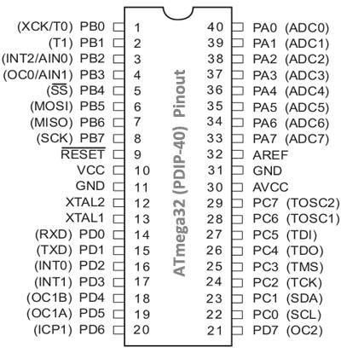
USART

Slide 14
Serial Peripheral Interface (SPI)
The receiver and transmitter share a common clock line.
The device considered the 'Master' provides a clock signal used to synchronize data transactions between the two devices.
Supports higher data rates.
A SPI interface uses a 3-wire system
MOSI, MISO, SCK

Slide 15
Serial Peripheral Interface (SPI)

Slide 16
Two-wire Serial Interface (TWI)
Network several devices such as microcontrollers and display boards, using a two-wire bus.
7 bit address
Up to 128 devices are supported
Each device has a unique address and can exchange data with other devices in a small network.
TWI is ATmega32 version of Phillips’ I²C
Inter-Integrated Circuit, pronounced "I squared C"

Slide 17
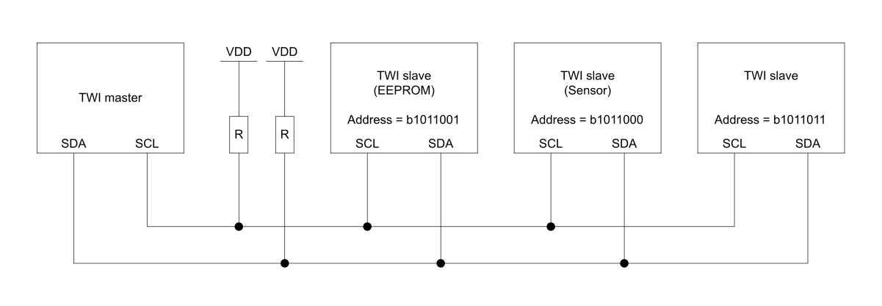
Two-wire Serial Interface (TWI)
A sample TWI network connecting 3 devices with TWI master.

Slide 18
Two-wire Serial Interface (TWI)

Slide 19
Serial communications terminology
Parity bit: a single bit that is sent together with data bits to make the total number of 1’s even (for even parity) or odd (for odd parity)
used for error checking.
Start bit: to indicate the start of a character. Its typical value is 0.
Stop bit: to indicate the end of a character. Its typical value is 1

Slide 20
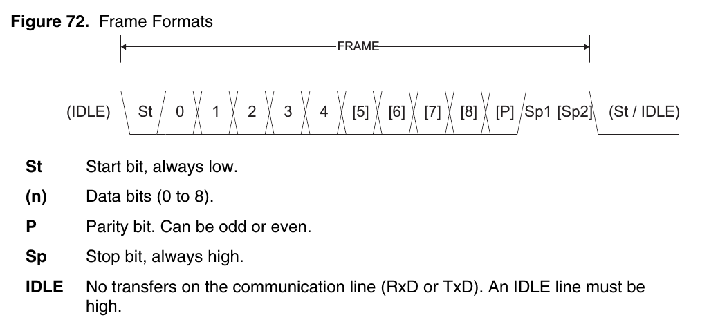
Data Framing - Asynchronous
A frame starts with the start bit followed by the least significant data bit.

Slide 21
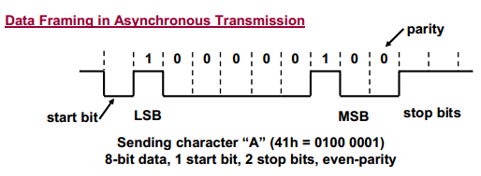
Data Framing - Asynchronous
Example:

Slide 22
USART in ATmega16 – An Overview
baud rates from 960bps up to 57.6kbps
technically baud rate refers to symbols per second
for our case baud rate is equal to bit-rate
character size: 5 to 9 bits
1 start bit
1 or 2 stop bits
parity bit (optional: even or odd parity)

Slide 23
USART – Hardware Elements
USART Transmitter:
to send a character through TxD pin.
to handle start/stop bit framing, parity bit, shift register.
USART Receiver:
to receive a character through RxD pin.
to perform the reverse operation of the transmitter

Slide 24
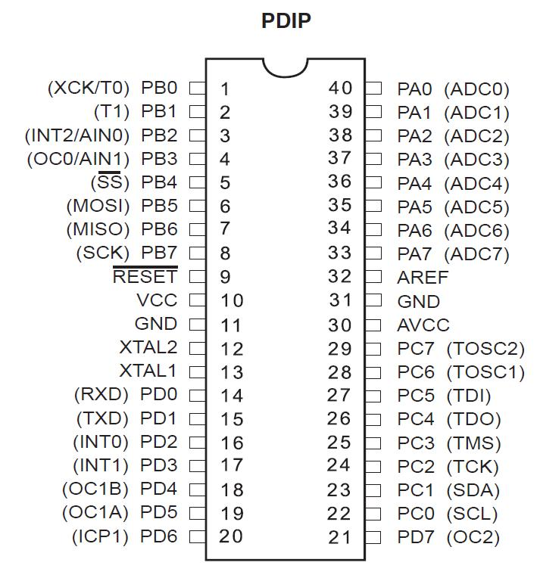
PINOUT
RXD
To recieve
TXD
To transmit

Slide 25
USART - Registers
Three set of registers
USART Baud Rate Registers
UBRRH and UBRRL
Sets the speed of communication
USART Control and Status Registers
UCSRA, UCSRB, and UCSRC
USART Data Register
UDR
Used to read and write actual data!

Slide 26
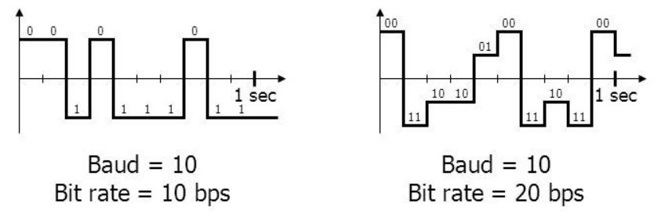
Baud rate
The number of bits sent per second (bps).
Strictly speaking, baud rate is the number of symbols per second.
Or, how many times signal changes states
As we have only two symbols 0 and 1, here baud rate is equal to bps

Slide 27
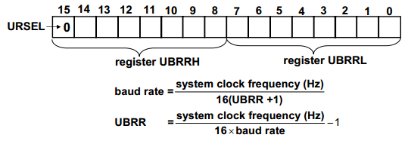
Setting Baud Rate
Must be 0 when setting the baud rate
Two register UBRRH and UBRRL are used together to set the baud rate
There is also a double speed transmission mode, where the 16 is replaced by 8 in the formula

Slide 28
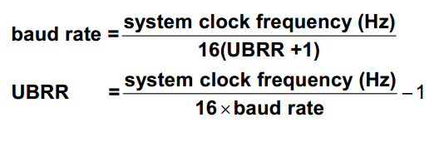
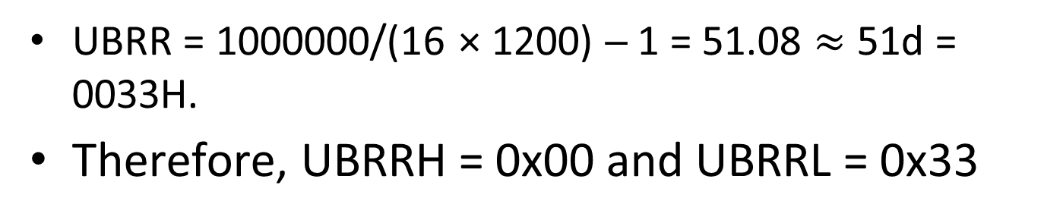
Setting Baud Rate – An Example
Find UBRR registers for baud rate of 1200bps, assuming system clock is 1MHz
UBRR = 1000000/(16 × 1200) ─ 1 = 51.08 $≈$ 51d = 0033H.
Therefore, UBRRH = 0x00 and UBRRL = 0x33

Slide 29
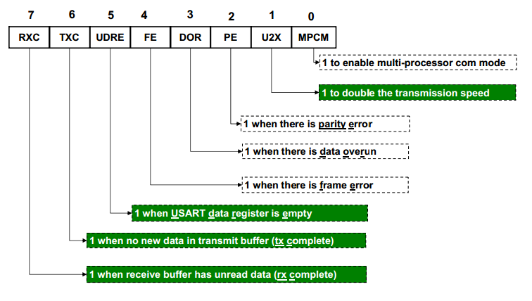
USART Control and Status Register A (UCSRA)
Used for checking status of communication

Slide 30
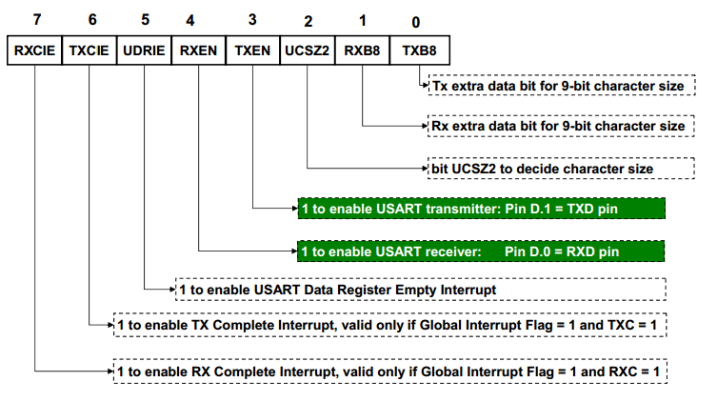
USART Control and Status Register B (UCSRB)

Slide 31
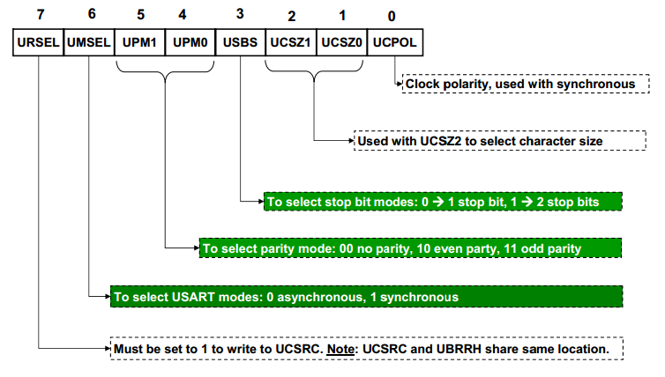
USART Control and Status Register C (UCSRC)

Slide 32
Setting character size
Characters can be 5 to 9 bits long
Three bits are designated to configure the character size
bit UCSZ2 (in register UCSRB)
bit UCSZ1 and UCSZ0 (in register UCSRC)

Slide 33
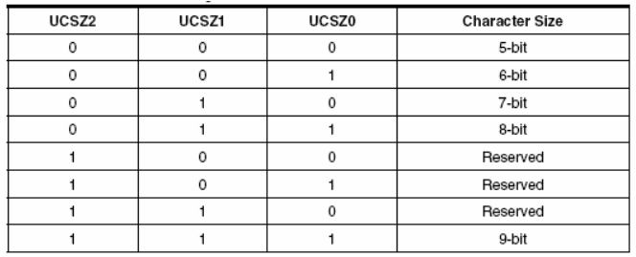
Setting character size

Slide 34
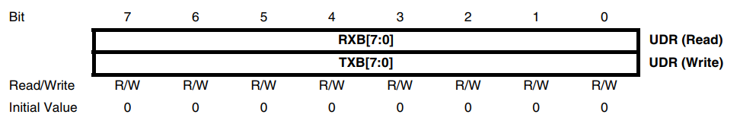
USART Data Register - UDR
Register UDR is the buffer for characters sent or received through the serial port
Two buffer, Same address (name)

Slide 35
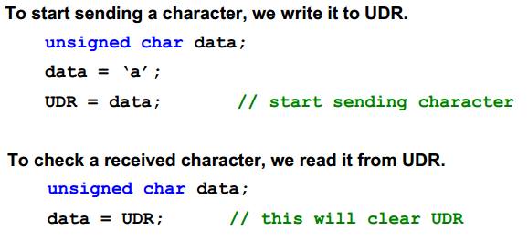
USART Data Register - UDR
Register UDR is the buffer for characters sent or received through the serial port

Slide 36
Learning Goals
Initializing the serial port.
Sending and receiving a character.
Sending/receiving formatted strings

Slide 37
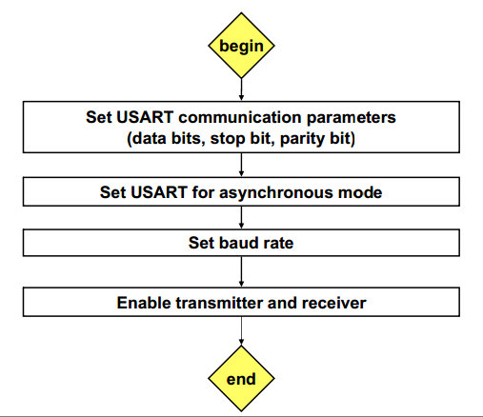
Initializing Serial Port

Slide 38
Initialize ATmega32 for UART with the following parameters: baud rate 1200 bps, no parity, 1 stop bit, 8 data bits. Assume a clock speed of 1MHz and polling approach.

Slide 39
C Code
void UART_init(void){ // Normal speed, disable multi-proc UCSRA = 0b00000000; // Enable Tx and Rx, disable interrupts UCSRB = 0b00011000; // Asynchronous mode, no parity, 1 stop bit, 8 data bits UCSRC = 0b10000110; // Baud rate 1200bps, assuming 1MHz clock UBRRL = 0x33; UBRRH = 0x00; }

Slide 40
C Code
void UART_init(void){ // Normal speed, disable multi-proc UCSRA = 0b00000000; // Enable Tx and Rx, disable interrupts UCSRB = 0b00011000; // Asynchronous mode, no parity, 1 stop bit, 8 data bits UCSRC = 0b10000110; // Baud rate 1200bps, assuming 1MHz clock UBRRL = 0x33; UBRRH = 0x00; }

Slide 41
C Code
void UART_init(void){ // Normal speed, disable multi-proc UCSRA = 0b00000000; // Enable Tx and Rx, disable interrupts UCSRB = 0b00011000; // Asynchronous mode, no parity, 1 stop bit, 8 data bits UCSRC = 0b10000110; // Baud rate 1200bps, assuming 1MHz clock UBRRL = 0x33; UBRRH = 0x00; }

Slide 42
C Code
void UART_init(void){ // Normal speed, disable multi-proc UCSRA = 0b00000000; // Enable Tx and Rx, disable interrupts UCSRB = 0b00011000; // Asynchronous mode, no parity, 1 stop bit, 8 data bits UCSRC = 0b10000110; // Baud rate 1200bps, assuming 1MHz clock UBRRL = 0x33; UBRRH = 0x00; }

Slide 43
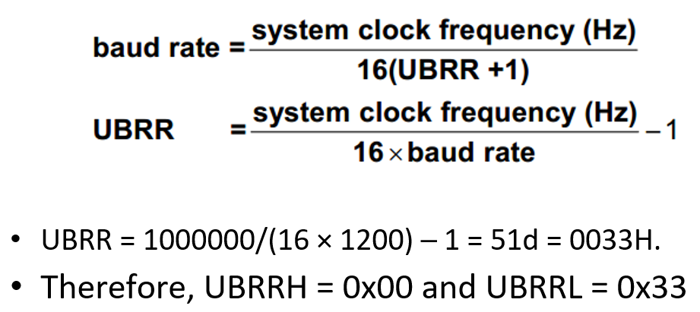
C Code
void UART_init(void){ // Normal speed, disable multi-proc UCSRA = 0b00000000; // Enable Tx and Rx, disable interrupts UCSRB = 0b00011000; // Asynchronous mode, no parity, 1 stop bit, 8 data bits UCSRC = 0b10000110; // Baud rate 1200bps, assuming 1MHz clock UBRRL = 0x33; UBRRH = 0x00; }

Slide 44
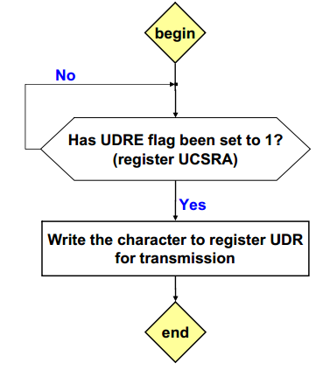
Sending a character (Polling)

Slide 45
Write a C function to send a character through the serial port of ATmega16 (Polling)

Slide 46
C Code
void UART_send(unsigned char data){ // wait until UDRE flag is set to logic 1 while ((UCSRA & (1<<UDRE)) == 0x00); UDR = data; // Write character to UDR for transmission }

Slide 47
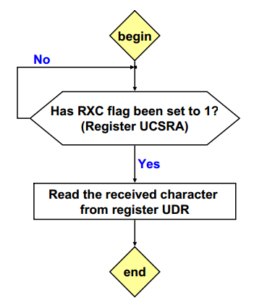
Receiving a character (Polling)

Slide 48
Write a C function to receive a character through the serial port of ATmega16 (Polling)

Slide 49
C Code
unsigned char UART_receive(void){ // Wait until RXC flag is set to logic 1 while ((UCSRA & (1<<RXC)) == 0x00); return UDR; // Read the received character from UDR }

Slide 50
Sending/receiving formatted strings
Write two functions to send and receive a character through serial port.
Already done - UART_send and UART_receive
2) In main program, call fdevopen() to designate the two functions as the handlers for standard output and standard input device.
3) Use printf/scanf as usual. Formatted strings will be sent/received through serial port.

Slide 51
C Code
#include <avr/io.h> #include <stdio.h>
int main(void)
{ unsigned char a; // … Code to initialise baudrate, TXD, RXD, and so on is not shown here // Initialise the standard IO handlers stdout = fdevopen(UART_send, NULL); stdin = fdevopen(NULL, UART_receive); // Start using printf, scanf as usual while (1){ printf(“\n\rEnter a = "); scanf(“%d”, &a); printf(“%d”, a); } }

Slide 52
Now, it is time to implement our knowledge in a sample application

Slide 53
Program a camera to rotate repetitively
Connection Parameters
8 data bit
1 stop bit
no parity bit
baud rate 9600bps
Control: Sending character “4” or “6” turns the camera left or right, respectively

Slide 54
Setting Baud Rate
In normal mode, the calculation leads to a UBR of 6.51-1 = 5.51
Hence the UBR would have to be set to 5 or, 6
Thus we will use double speed mode to be more precise

Slide 55
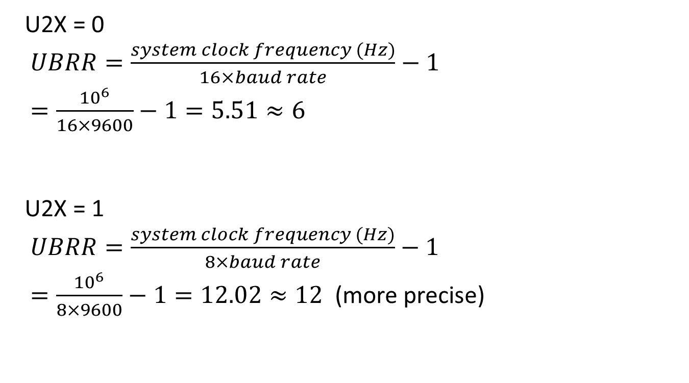
Setting Baud Rate
U2X = 0
$UBRR=\frac{system clock frequency (Hz)}{16×baud rate}−1$
$=\frac{{10}^{6}}{16×9600}−1=5.51≈6$
U2X = 1
$UBRR=\frac{system clock frequency (Hz)}{8×baud rate}−1$
$=\frac{{10}^{6}}{8×9600}−1=12.02≈12$ (more precise)

Slide 56
C Code - Initialize
void USART_init(void)
{
UCSRA = 0b00000010; // double speed
UCSRB = 0b00011000; // Enable Tx and Rx, polling
UCSRC = 0b10000110; // Async mode, no parity, 1 stop bit, 8 data bits
//in double-speed mode, UBRR = clock/(8xbaud rate) - 1
UBRRH = 0;
UBRRL = 12; // Baud rate 9600bps, assuming 1MHz clock
}

Slide 57
C Code – Main Loop
int main(void)
{
unsigned char i;
USART_init(); // initialise USART
while (1) {
for (i=0; i<10; i++)// rotate left 10 times
{
UART_send('4');
delay();
}
for (i=0; i < 10; i++)//rotate right 10 times {
UART_send('6');
delay();
}
}
}

Slide 58
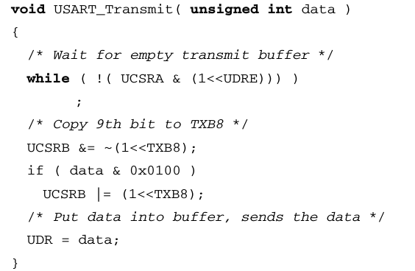
Sending 9 bit characters
The ninth bit must be written to the TXB8 bit in UCSRB before the low byte of the character is written to UDR
UCSRB

Slide 59
Reception of 9 bit characters and status flags
Reading UDR changes the RXB8, FE, DOR and PE bits
Always read status from UCSRA and the 9th bit from RXB8 in UCSRB BEFORE
reading data from UDR.

Slide 60
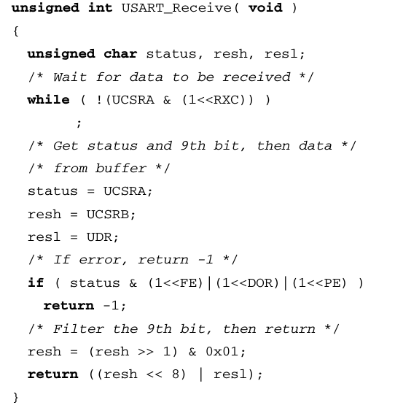
Reception of 9 bit characters and status flags

Slide 61
Transmission
To start transmission data is written in the buffer (UDR)
The buffered data will be moved to the Shift Register when the Shift Register is ready to send a new frame, i.e, it has no bits left to send.
if it is in idle state (no ongoing transmission) or
immediately after the last stop bit of the previous frame is transmitted.

Slide 62
Reception
The receiver starts data reception when it detects a valid start bit.
Each bit that follows the start bit will be sampled at the baud rate or XCK clock, and shifted into the receive Shift Register until the first stop bit of a frame is received.
A second stop bit will be ignored by the receiver.

Slide 63
Reception
When the first stop bit is received, a complete serial frame is present in the receive Shift Register, the contents of the Shift Register is then moved into the receive buffer.
The receive buffer can then be read from UDR.

Slide 64
Frame Error
A UART will detect a framing error when it does not see a "stop" bit at the expected "stop" bit time.
A FE (Frame Error) will be detected in the cases where the first stop bit is zero.
The receiver ignores the second stop bit

Slide 65
Data OverRun Error (DOR)
The Data OverRun (DOR) Flag indicates data loss due to a receiver buffer full condition.
A Data OverRun occurs when the receive buffer (UDR) is full (two characters), it is a new character waiting in the receive Shift Register, and a new start bit is detected.
If the DOR Flag is set there was one or more serial frame lost between the frame last read from UDR, and the next frame read from UDR.

Slide 66
Checking Transmission Status
The USART transmitter has two flags that indicate its state:
USART Data Register Empty (UDRE)
Transmit Complete (TXC).
The Data Register Empty (UDRE) Flag indicates whether the transmit buffer is ready to receive new data.
This bit is set when the transmit buffer is empty
and not set when not empty ( has unmoved data to shift register).

Slide 67
Checking Transmission Status
The Transmit Complete (TXC) Flag bit is set one when
the entire frame in the transmit Shift Register has been shifted out, and
there are no new data currently present in the transmit buffer.
The TXC Flag bit is automatically cleared when
a transmit complete interrupt is executed, or
it can be cleared by writing a one to its bit location

Slide 68
Checking TXC flag to check transmission status
The TXC Flag must be cleared before each transmission (before UDR is written)
If, not, then what will be the problem ???

Slide 69
Transmission using UDRIE Interrupt
The USART Data Register Empty Interrupt will be executed as long as UDRE is set.
UDRE is cleared by writing UDR.
When interrupt-driven data transmission is used, the Data Register Empty Interrupt routine must
either write new data to UDR in order to clear UDRE or
disable the Data Register empty Interrupt
No such problem with TXCIE interrupt

Slide 70
Reception using RXCIE interrupt
When the Receive Complete Interrupt Enable (RXCIE) in UCSRB is set, the USART Receive Complete Interrupt will be executed as long as the RXC Flag is set
The receive complete routine must read the received data from UDR in order to clear the RXC Flag
otherwise a new interrupt will occur once the interrupt routine terminates.

Slide 71
Double Speed Mode Disadvantage
The receiver will use half the number of samples (reduced from 16 to 8) for data sampling and clock recovery (syncing the internal clock to the incoming serial frames)
Hence, a more accurate baud rate setting and system clock are required.
For the transmitter, there are no downsides.

Slide 72
Disabling Transmission and Reception
The disabling of the transmitter (setting the TXEN to zero) will not become effective until ongoing and pending transmissions are completed
The disabling of reception (setting the RXEN to zero) is immediate
Disabling reception flushes the receive buffer immediately

Slide 73
Asynchronous Data Reception
Clock Recovery
Detect Start Bit
Data Recovery
Detect Data Bits, Parity Bit, Stop Bit

Slide 74
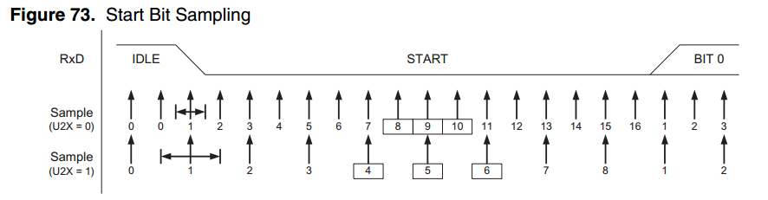
Asynchronous Clock Recovery
The clock recovery logic synchronizes internal clock to the incoming serial frames.
The sample rate is 16 times the baud rate for Normal mode, and 8 times the baud rate for Double Speed mode.

Slide 75
Asynchronous Clock Recovery
Samples denoted zero are samples done when the RxD line is idle (that is, no communication activity).
When the clock recovery logic detects a high (idle) to low (start) transition on the RxD line, the start bit detection sequence is initiated.

Slide 76
Asynchronous Clock Recovery
The clock recovery logic uses samples 8, 9, and 10 for Normal mode, and samples 4, 5, and 6 for Double Speed mode
If two or more of these three samples have logical high levels (the majority wins), the start bit is rejected as a noise spike and the receiver starts looking for the next high to low-transition.

Slide 77
Asynchronous Clock Recovery
If however, a valid start bit is detected, the clock recovery logic is synchronized and the data recovery can begin.
The synchronization process is repeated for each start bit.

Slide 78
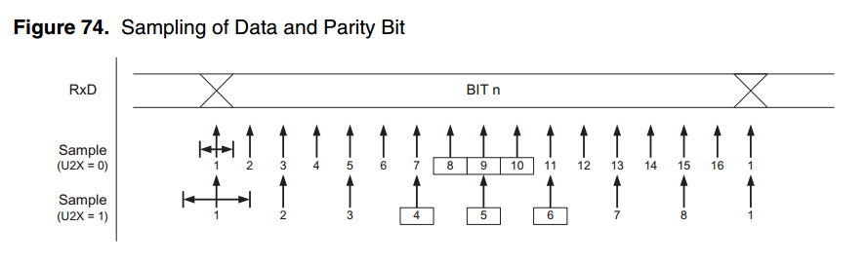
Asynchronous Data Recovery
The decision of the logic level of the received bit is taken by doing a majority voting of the logic value to the three samples in the center of the received bit.
The parity bit and the first stop bit is also sampled this way

Slide 79
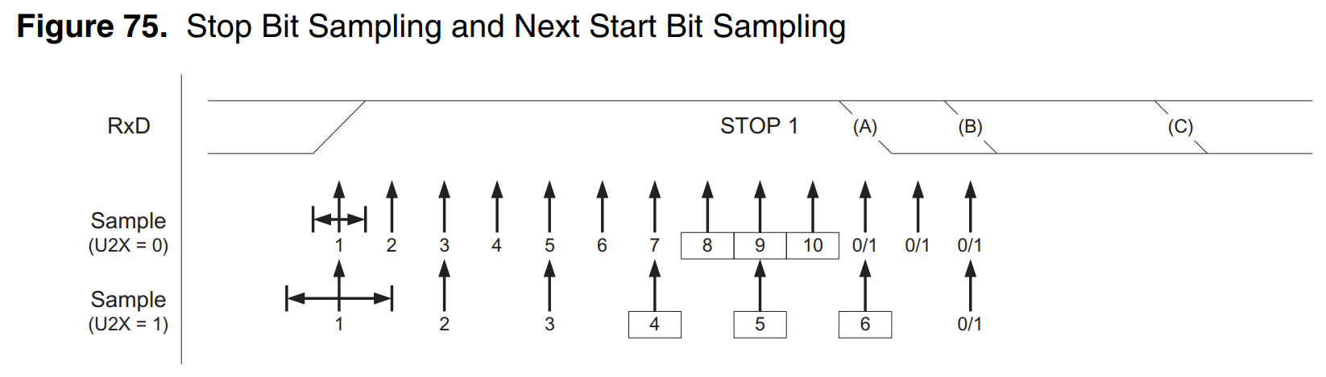
Asynchronous Data Recovery
The same majority voting is done to the stop bit as done for the other bits in the frame.
If the stop bit is registered to have a logic 0 value, the Frame Error (FE) Flag will be set.

Slide 80
SPI

Slide 81
Serial Peripheral Interface (SPI)
The receiver and transmitter share a common clock line.
The device considered the 'Master' provides a clock signal used to synchronize data transactions between the two devices.
Supports higher data rates than UART.
A SPI interface uses a 3-wire system
MOSI, MISO, SCK
There is also a slave select pin, which is used to activate slave

Slide 82
PIN Description
SPI uses 4 pins for communications
MISO – MISO stands for Master In Slave Out. MISO is the input pin for Master, and output pin for Slave device. Data transfer from Slave to Master takes place through this channel.
MOSI – MOSI stands for Master Out Slave In. This pin is the output pin for Master and input pin for Slave. Data transfer from Master to Slave takes place through this channel.

Slide 83
PIN Description
3. SCK – This is the SPI clock line
Master generates a clock signal in this PIN which is fed to the slave
4. SS – This stands for Slave Select.
This pin is used to activate/select a slave

Slide 84
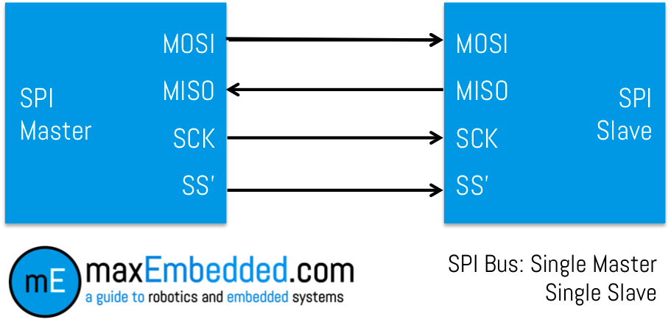
SPI Connection: Single Slave

Slide 85
SPI
Both, Master and Slave place the data (byte) they wish to transfer in their respective shift registers before the communication starts.
Master generates 8 clock pulses. After each clock pulse, one bit of information is transfer from Master to Slave and vice-versa.
After 8 clock pulses, Master would have received Slave’s data, whereas Slave would have Master’s data. And that’s why this is a full-duplex communication.

Slide 86
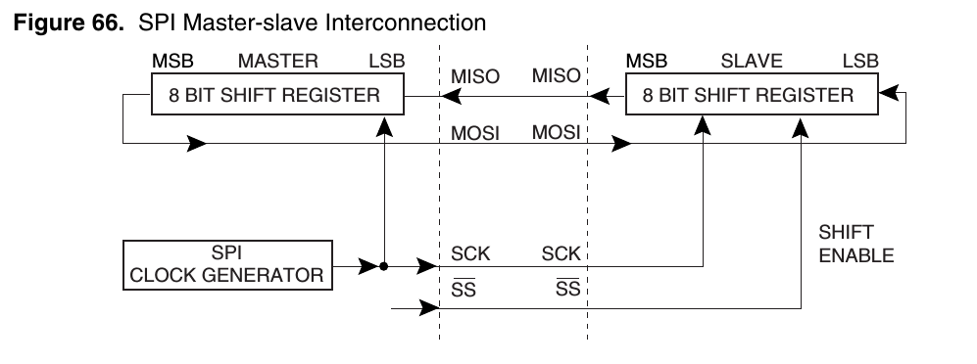
SPI Master-slave Interconnection
Slave select line should activate slave before starting transmission and deactivate it after finishing communication.
Any free pin of the Master can be used to drive the Slave Select line of the slave
The SS line of Master, if configured as output is typically used to drive a slave

Slide 87
SPI Master-slave Interchange
Example of Master Slave byte exchange per clock pulse
This example assumes MSB is transferred first (DORD=0)
Pulse | Master | Slave
0 | 10100110 | 11001011
1 | 01001101 | 10010111
2 | 10011011 | 00101110
3 | 00110110 | 01011101
4 | 01101100 | 10111010
5 | 11011001 | 01110100
6 | 10110010 | 11101001
7 | 01100101 | 11010011
8 | 11001011 | 10100110

Slide 88
Slave Select Line Functionality - Slave Mode
When the SPI is configured as a Slave, the Slave Select (SS) pin is always input.
When SS is held low, the SPI is activated
When SS is driven high, it will not receive incoming data.

Slide 89
Slave Select Line Functionality - Master Mode
When the SPI is configured as a Master (MSTR in SPCR is set), the user can determine the direction of the SS pin.
If SS is configured as an output, the pin is a general output pin which does not affect the SPI system.
Typically, the pin will be driving the SS pin of the SPI Slave.

Slide 90
Slave Select Line Functionality - Master Mode
When configured as a Master, the SPI interface has no automatic control of the SS line.
This must be handled by user software before communication can start.

Slide 91
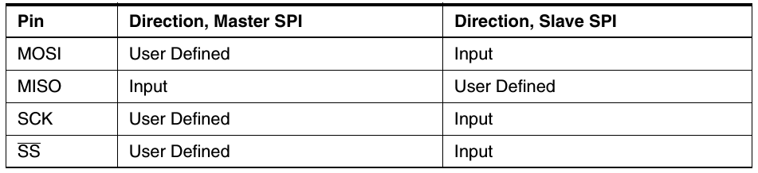
SPI Pin Overrides
When the SPI is enabled, the data direction of the MOSI, MISO, SCK, and SS pins is overridden according to following table

Slide 92
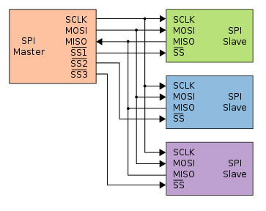
Working with Multiple Slave
All the Slaves share the same MOSI, MISO and SCK signals.
The SS’ signal is responsible for choosing a particular Slave.
The Slave gets enabled only when its input SS’ signal goes LOW.

Slide 93
Register Descriptions
Three registers deal with SPI:
SPCR – SPI Control Register
It contains the bits to initialize SPI and control it.
SPSR – SPI Status Register
This register is used to read the status of the bus lines.
SPDR – SPI Data Register
The SPI Data Register is the read/write register where the actual data transfer takes place.

Slide 94
SPI - Transmission Steps
The SPI Master initiates the communication cycle by pulling low the Slave Select pin of the desired Slave.
Master writes the byte to send in SPDR
Step 2 triggers the the SPI clock generator of the Master to generate the required clock pulses on the SCK line to interchange data.

Slide 95
SPI - Transmission Steps
4. After shifting one byte, the SPI clock generator stops, setting the end of Transmission Flag (SPIF). If the SPI Interrupt is enabled an interrupt is issued.
5. The Master may continue to shift the next byte by writing it into SPDR, or signal the end of packet by pulling high the Slave Select line.

Slide 96
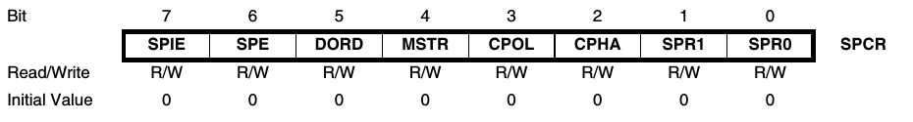
SPI Control Register - SPCR
Bit 7 – SPIE: SPI Interrupt Enable
This bit causes the SPI interrupt to be executed if SPIF bit in the SPSR Register is set
Bit 6 – SPE: SPI Enable
written one to enable the SPI
Bit 5 – DORD: Data Order
When the DORD bit is written to one, the LSB of the data word is transmitted first.
When the DORD bit is written to zero, the MSB of the data word is transmitted first.

Slide 97
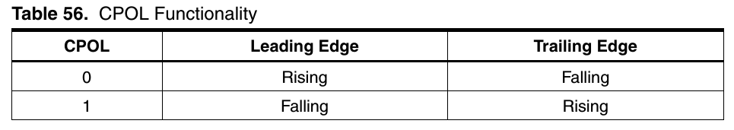
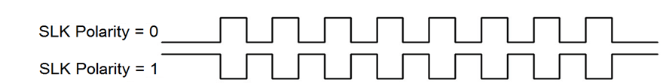
SPI Control Register - SPCR
Bit 4 – MSTR: Master/Slave Select
1 for Master and 0 for Slave
Bit 3 – CPOL: Clock Polarity
The CPOL functionality is summarized below:
Idle State
LOW
HIGH

Slide 98
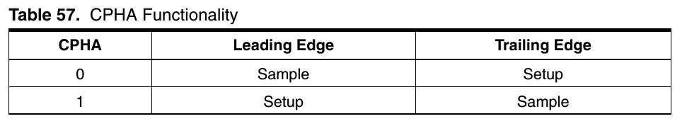
SPI Control Register - SPCR
Bit 2 – CPHA: Clock Phase
The settings of the Clock Phase bit (CPHA) determine if data is sampled on the leading (first) or trailing (last) edge of SCK.

Slide 99
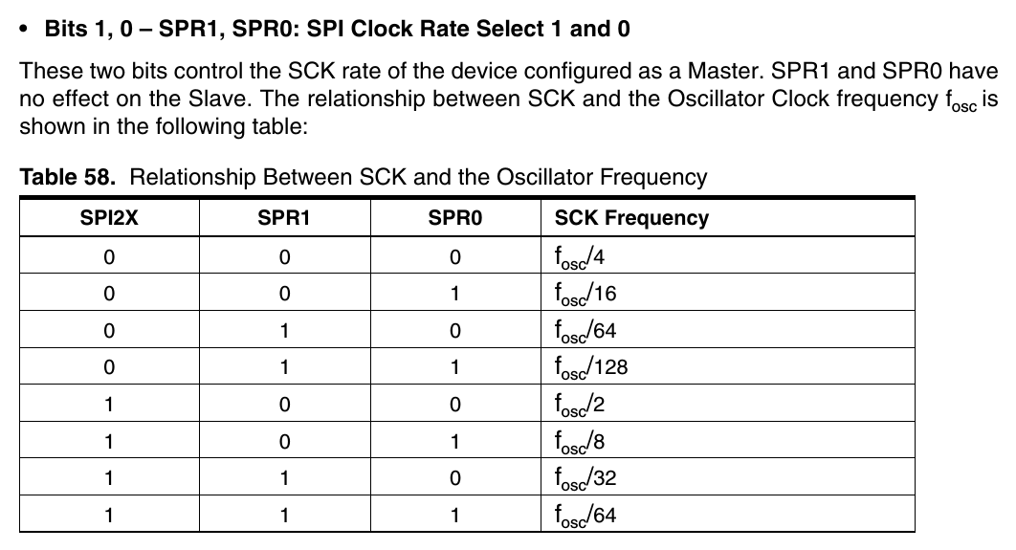
SPI Control Register - SPCR

Slide 100
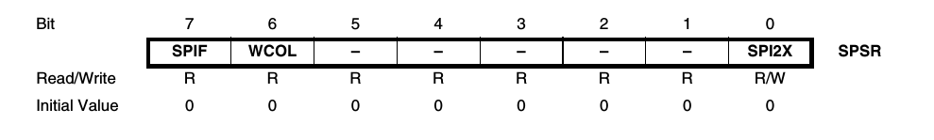
SPI Status Register - SPSR
Bit 7 – SPIF: SPI Interrupt Flag
When a serial transfer is complete, the SPIF Flag is set. Interrupt is generated if enabled
SPIF is cleared by hardware when executing the corresponding interrupt handling vector.
Alternatively, the SPIF bit is cleared by first reading the SPI Status Register with SPIF set, then accessing the SPI Data Register (SPDR).

Slide 101
SPI Status Register - SPSR
Bit 6 – WCOL: Write Collision Flag
The WCOL bit is set if the SPI Data Register (SPDR) is written during a data transfer.
Bit 0 – SPI2X: Double SPI Speed Bit
When this bit is written logic one the SPI speed (SCK Frequency) will be doubled when the SPI is in Master mode

Slide 102
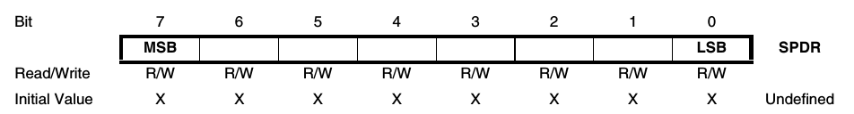
SPI Data Register - SPDR
The SPI Data Register is used for data transfer.
Writing to the register initiates data transmission.
Reading the register causes the Shift Register Receive buffer to be read.

Slide 103

PINOUT

Slide 104
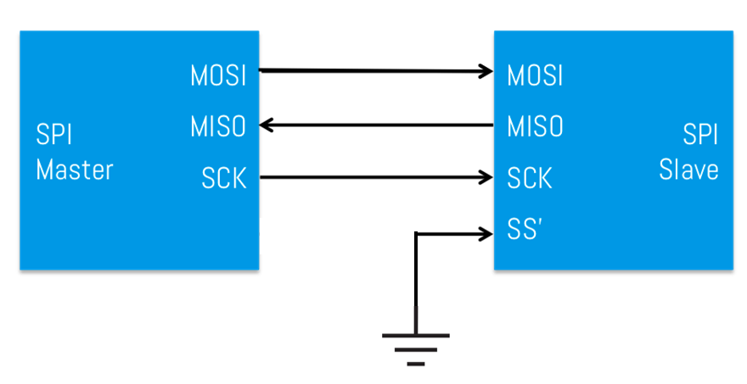
SPI – Sample Setup

Slide 105
SPI – Master Config
void SPI_MasterInit(void)
{
/* Set MOSI and SCK output, all others input */
DDRB = (1<<DDB5)|(1<<DDB7);
/* Enable SPI, Master, set clock rate fck/16 */
SPCR = (1<<SPE)|(1<<MSTR)|(1<<SPR0);
}

Slide 106
SPI – Slave Config
void SPI_SlaveInit(void)
{
/* Set MISO output, all others input */
DDRB = (1<<DDB6);
/* Enable SPI */
SPCR = (1<<SPE);
}

Slide 107
SPI - Data sending
void SPI_MasterTransmit(char cData)
{
/* Start transmission */
SPDR = cData;
/* Wait for transmission complete */
while(!(SPSR & (1<<SPIF)));
}

Slide 108
SPI - Data Receiving
char SPI_SlaveReceive(void)
{
/* Wait for reception complete */
while(!(SPSR & (1<<SPIF)));
/* Return data register */
return SPDR;
}

Slide 109
How to perform duplex operation: send and receive simultaneously ?

Slide 110
SPI – Data Exchange
char SPI_Transceiver(char cData)
{
/* Start transmission */
SPDR = cData;
/* Wait for transmission complete */
while(!(SPSR & (1<<SPIF)));
/* Return newly received data */
Return SPDR;
}

Slide 111
SPDR buffer
The system is single buffered in the transmit direction and double buffered in the receive direction.
This means that bytes to be transmitted cannot be written to the SPI Data Register before the entire shift cycle is completed.
When receiving data, however, a received character must be read from the SPI Data Register before the next character has been completely shifted in. Otherwise, the first byte is lost.

Slide 112
Data Modes
There are four combinations of SCK phase and polarity with respect to serial data, which are determined by control bits CPHA and CPOL.
Data bits are shifted out and latched in on opposite edges of the SCK signal
ensuring sufficient time for data signals to stabilize.
Sample = Data Reading
Setup = Shifting

Slide 113
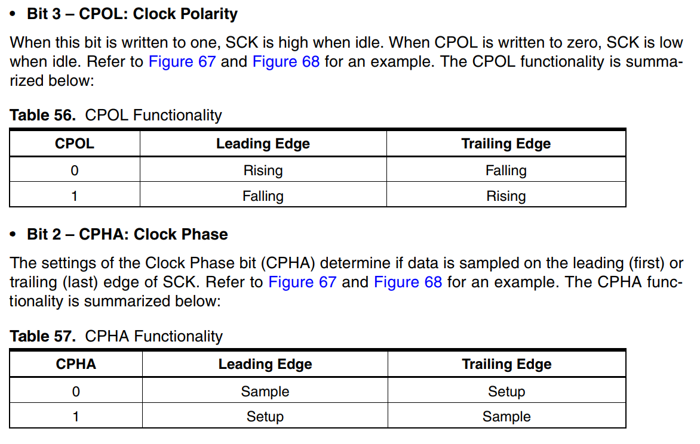

Slide 114
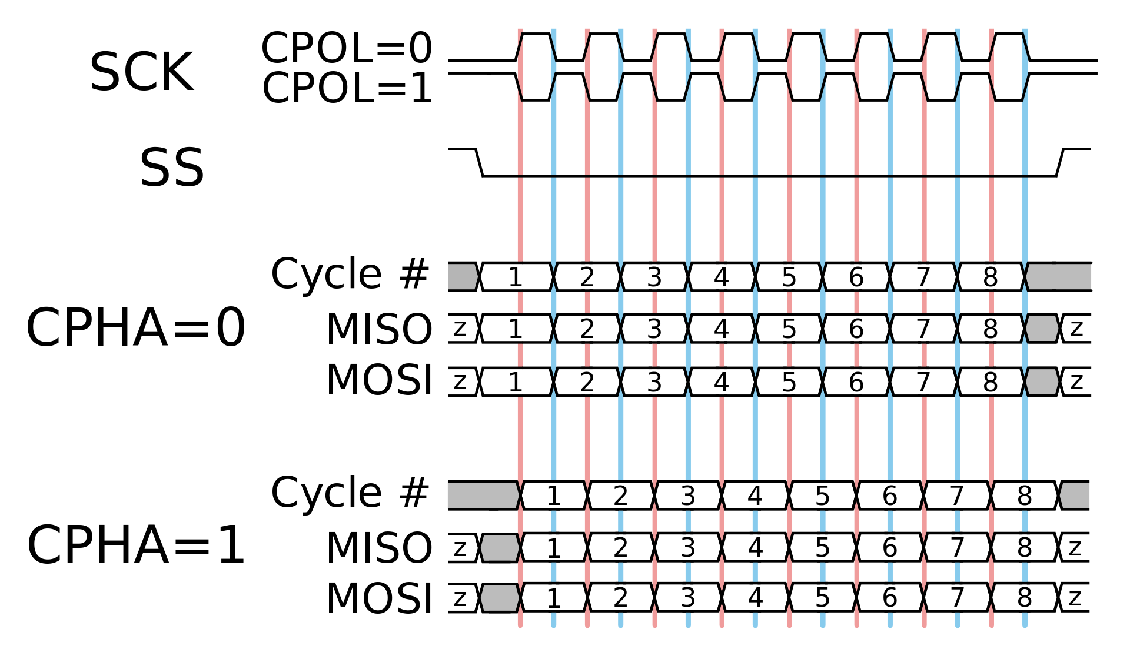
Leading edge
Trailing edge

Slide 115
Leading edge
Trailing edge

Slide 116
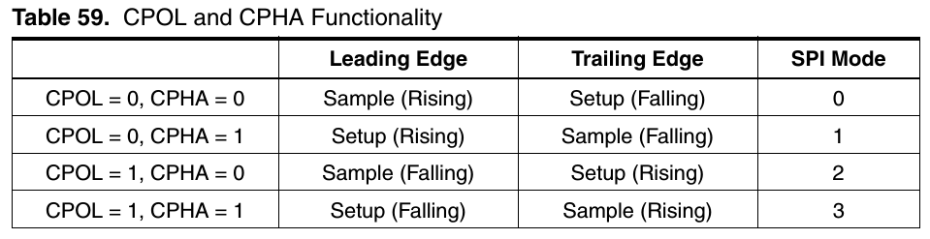
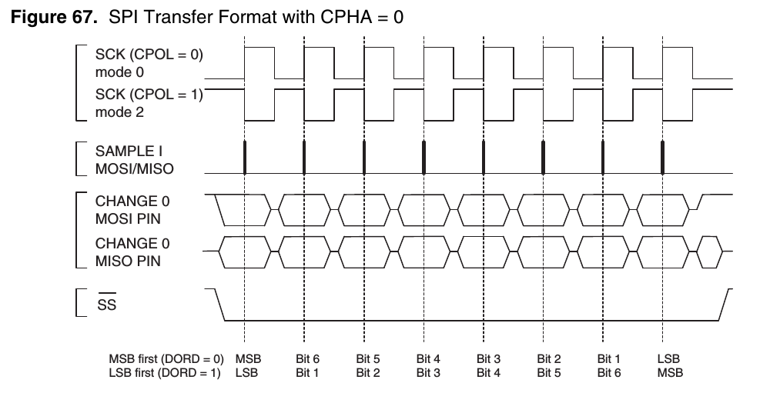
Data Modes

Slide 117
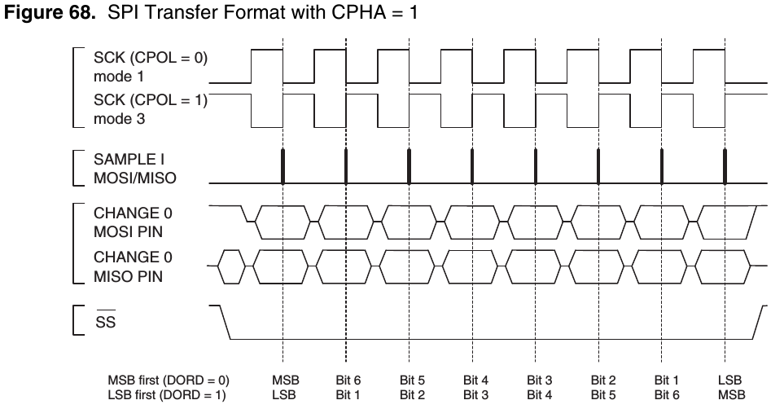
Data Modes

Slide 118
Bit Banging (Not for exams)
SPI can also be done without using any dedicated hardware of the uC.
The SPI properties are simulated by programming
The technique is called Bit Banging

Slide 119
SPI resources
http://maxembedded.com/2013/11/the-spi-of-the-avr/
http://maxembedded.com/2013/11/serial-peripheral-interface-spi-basics/
http://www.avrfreaks.net/forum/atmega32-spi-sample-code
http://www.circuitstoday.com/how-to-work-with-spi-in-avr-micro-controllers
http://www.embedds.com/serial-peripheral-interface-in-avr-microcontrollers/

Slide 120
Bit Banging
https://electronics.stackexchange.com/questions/44670/what-is-bit-banging
https://en.wikipedia.org/wiki/Bit_banging

Slide 121
Have A Look
SPI: The serial peripheral interface [Ben Eater]
https://www.youtube.com/watch?v=MCi7dCBhVpQ
PROTOCOLS: UART - I2C - SPI - Serial communications
https://www.youtube.com/watch?v=IyGwvGzrqp8

Slide 122
☺

